Slide 1
Taking a shot at free throws
Analytics Team:
Dipika Kumar
Robert Schroer
Isaac Winters
Chidera Nwaubi

Slide 2
Motivation & Summary
If a team has a higher free throw percentage, then they will have more wins
Free throws can impact a team’s ability to win

Slide 3
Questions
Do teams that win more games have a higher free throw percentage?
Do teams that win more games have more free throw attempts?
Do teams that win more games make more free throws?
Is there a bias in free throw attempts toward home teams?
if referees are biased towards home teams when it comes to calling fouls?
Do free throws win games?

Slide 4
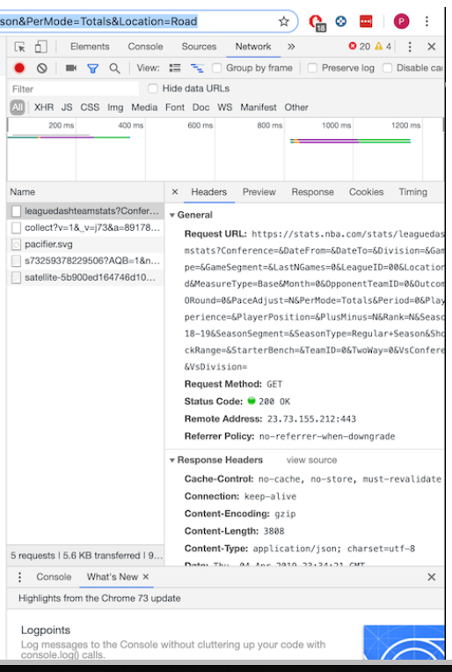
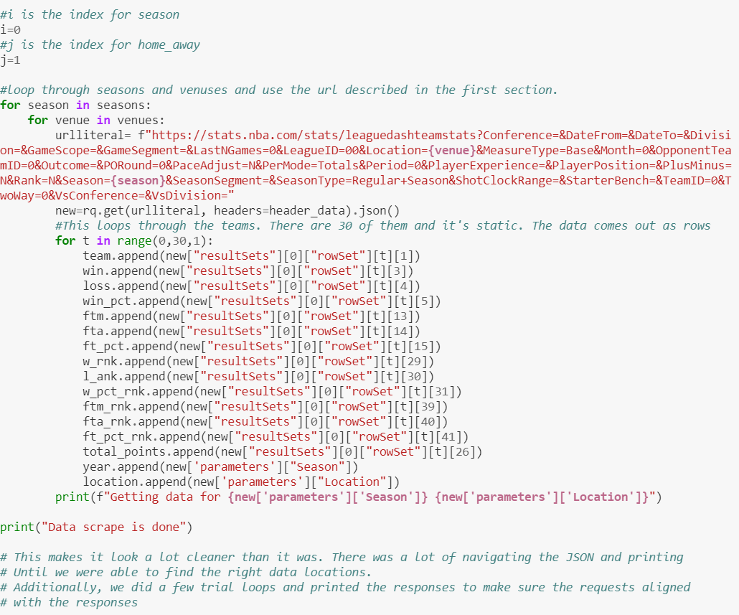
Our Data Source

Slide 5
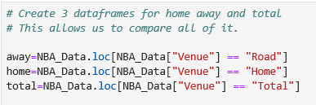
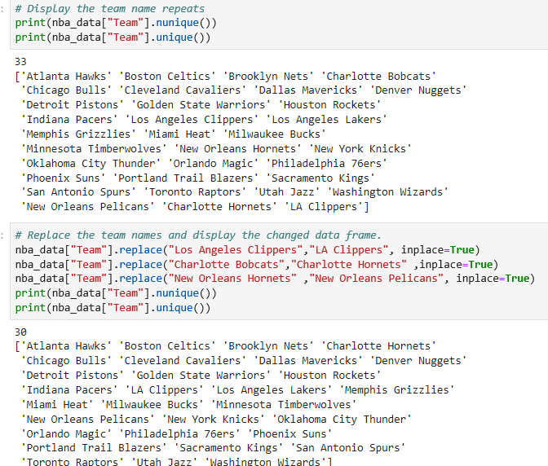
Data Clean-Up & Exploration
Game venue data
Problem discovery due to rank
Franchise name changes
More than 30 teams

Slide 6
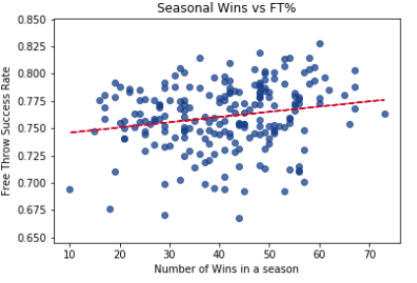
Data Analysis
Do free throws win games?
In this analysis we examined a team’s number of wins in a season in relation
to a team’s free throw percentage
there appears to be a visible trend but the line is underfit

Slide 7
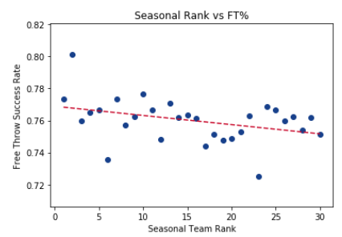
Data Analysis (Cont.)
Is there a correlation between win rankings and free throws?
Our next analysis was to explore the correlation between win rankings and free throws
Our underlying motive behind this analysis is that if teams are grouped by win rank, then the data will not necessarily follow teams, but an abstracted ranking of those teams for each year
While the previous graph appeared to show a trend, the line seemed to be underfit
We looked to see if there is a correlation between the average of the different free throw stats for each rank
I think that we can say that there is a slight trend between the two variables

Slide 8
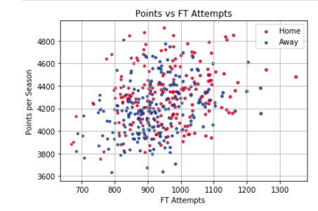
Data Analysis (Cont.)
More Free Throws Shot at Home or Away?
We wanted to see if there was any variation in the home or away games in the data.
Any variation could indicate referee bias.
To view this, we put it all on the same graph.
There appears to be a cluster in the upper right that bears this out
We plotted Points versus FT Attempts to see if we can visualize how much free throw attempts contribute to points.

Slide 9
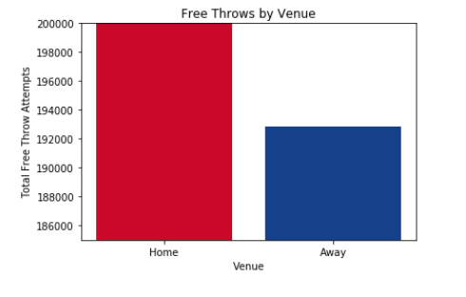
Data Analysis (Cont.)
Comparison of free throw attempts at home venue vs. away venue
Difference of 8000 attempts

Slide 10
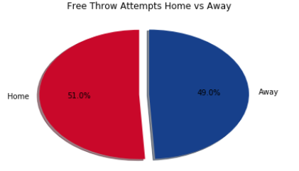
Data Analysis (Cont.)
Perception Matters
The previous graphs were misleading
When you look holistically at the data, there is only a 1% difference in the amount of Free Throw Attempts home and away
Because the previous bar graph was a summation, it made the appearance of a correlation when there was none
When you look at everything, there does not appear to be a significant bias

Slide 11
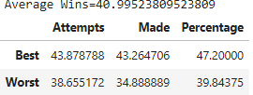
Data Analysis (Cont.)
Outside the Norm
We wanted to know which stats contributed more to wins in a season
We calculated the mean and standard deviation for the total combination of home and away games.
We found that teams were outside of the standard deviation on both ends of the spectrum.
Then, we compared the average of those populations with an average of the total population.
This is important because these relationships may not be linear and if we want to be best (or worst), then we'll want to see which factor contributes most on the edges.

Slide 12
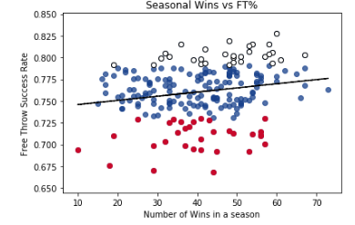
Data Analysis (Cont.)
Clumping or Clustering?
This graph was made to check to see if there was any clumping or clustering of in the wins versus free throw attempts.
It looks like there may be.

Slide 13
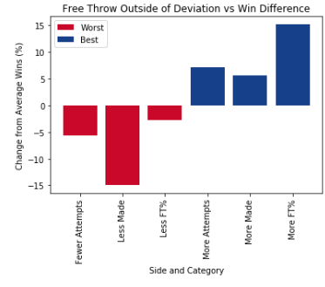
Data Analysis (Cont.)
what contributes more?
We were curious as to what factor contributed more to the best teams and the worst teams.
It looks like percentages matter more for the best, but didn't matter as much for the worst.

Slide 14
Findings
Better free throw shooting teams tend to have more wins
Yes there is a home court bias but it is not a large one

Slide 15
Post Mortem
Does more points equal more wins?
Obtain individual game data set
Free throw attempts home vs away based on the point differential for the game

Slide 16
Audience q&A

Slide 17
